Slide 1
Cornerstone City Church Peninsula Plus Community Hoo Are Ya
16th February 2025

Slide 2


Slide 3
House Of The Lord
CCLI Song # 7168995
© 2020 Phil Wickham MusicSimply Global SongsBe Essential SongsCashagamble Jet Music
For use solely with the SongSelect® Terms of Use. All rights reserved. www.ccli.com
Note: Reproduction of this sheet music requires a CCLI Music Reproduction Licence. Please report all copies.
CCLI Licence No. 33265

Slide 4
1/9
We worship the God who was
We worship the God who is
We worship the God who evermore will be
He opened the prison doors
He parted the raging sea
My God He holds the victory yeah

Slide 5
2/9
There’s joy in the house of the Lord
There’s joy in the house of the Lord today
And we won’t be quiet
We shout out Your praise

Slide 6
3/9
There’s joy in the house of the Lord
Our God is surely in this place
And we won’t be quiet
We shout out Your praise

Slide 7
4/9
We sing to the God who heals
We sing to the God who saves
We sing to the God who always makes a way
'Cause He hung up on that cross
Then He rose up from that grave
My God’s still rolling stones away

Slide 8
5/9
There’s joy in the house of the Lord
There’s joy in the house of the Lord today
And we won’t be quiet
We shout out Your praise

Slide 9
6/9
There’s joy in the house of the Lord
Our God is surely in this place
And we won’t be quiet
We shout out Your praise

Slide 10
7/9
We were the beggars
Now we’re royalty
We were the prisoners
Now we’re running free
We are forgiven accepted
Redeemed by His grace
Let the house of the Lord sing praise
(REPEAT)

Slide 11
8/9
There’s joy in the house of the Lord
There’s joy in the house of the Lord today
And we won’t be quiet
We shout out Your praise

Slide 12
9/9
There’s joy in the house of the Lord
Our God is surely in this place
And we won’t be quiet
We shout out Your praise

Slide 13
Never Gonna Stop Singing
CCLI Song # 7054533
Matt Vaughan | Ran Jackson | Tom Smith
© 2015 Brand Vaughan Music (Admin. by Capitol CMG Publishing)
Capitol CMG Genesis (Admin. by Capitol CMG Publishing)
Evident Music Publishing (Admin. by Capitol CMG Publishing)
Jesus Culture Music (Admin. by Capitol CMG Publishing)
Songsmiff Publishing (Admin. by Capitol CMG Publishing)
For use solely with the SongSelect® Terms of Use. All rights reserved. www.ccli.com
CCLI Licence No. 33265

Slide 14
1/5
You called out
Into darkness
You reached down
To save us

Slide 15
2/5
You conquered the grave
You crossed the divide
Lost in our sin You made us alive
How can we ever hold it inside
We can't hold back
We're gonna lift You

Slide 16
3/5
Higher higher
Hearts burning bright like a fire fire
Voices unite make it louder louder
We're never gonna stop singing
Oo we're never gonna stop (singing)

Slide 17
4/5
Set free
No longer bound in chains
You rescued me
And called me by name

Slide 18
5/5
Every tribe every tongue
Every heart will sing
Every knee we will bow to the risen King
Lift Him up lift Him up
We're never gonna stop singing
Oo never gonna stop

Slide 20
How Great Is Our God
CCLI Song # 4348399
Chris Tomlin | Ed Cash | Jesse Reeves
© 2004 sixsteps Music (Admin. by Integrity Music Ltd)
Vamos Publishing (Admin. by Integrity Music Ltd)
worshiptogether.com songs (Admin. by Integrity Music Ltd)
Wondrously Made Songs (Admin. by Song Solutions www.songsolutions.org)
For use solely with the SongSelect® Terms of Use. All rights reserved. www.ccli.com
CCLI Licence No. 33265

Slide 21
1/6
The splendour of the King
Clothed in majesty
Let all the earth rejoice
All the earth rejoice
He wraps Himself in light
And darkness tries to hide
And trembles at His voice
And trembles at His voice

Slide 22
2/6
How great is our God
Sing with me
How great is our God
And all will see how great
How great is our God

Slide 23
3/6
And age to age He stands
And time is in His hands
Beginning and the End
Beginning and the End
The Godhead three in one
Father Spirit Son
The Lion and the Lamb
The Lion and the Lamb

Slide 24
4/6
How great is our God
Sing with me
How great is our God
And all will see how great
How great is our God

Slide 25
5/6
Name above all names
Worthy of all praise
My heart will sing
How great is our God

Slide 26
6/6
How great is our God
Sing with me
How great is our God
And all will see how great
How great is our God

Slide 28
Holy Spirit
CCLI Song # 6087919
Bryan Torwalt | Katie Torwalt
© 2011 Capitol CMG Genesis (Admin. by Capitol CMG Publishing)
Jesus Culture Music (Admin. by Capitol CMG Publishing)
For use solely with the SongSelect® Terms of Use. All rights reserved. www.ccli.com
CCLI Licence No. 3326

Slide 29
1/5
There's nothing worth more that will ever come close
No thing can compare You're our living hope
Your Presence

Slide 30
2/5
I've tasted and seen of the sweetest of loves
Where my heart becomes free and my shame is undone
In Your Presence Lord

Slide 31
3/5
Holy Spirit You are welcome here
Come flood this place and fill the atmosphere
Your glory God is what our hearts long for
To be overcome by Your Presence Lord

Slide 32
4/5
Let us become more aware of Your Presence
Let us experience the glory of Your goodness (Lord)

Slide 33
5/5
There's nothing worth more that will ever come close
No thing can compare You're our living hope
Your Presence

Slide 34
Spirit Break Out CCLI Song # 6058450
Ben Bryant | Luke Hellebronth | Myles Dhillon | Tim Hughes
© 2010 Thankyou Music (Admin. by Integrity Music)
For use solely with the SongSelect® Terms of Use. All rights reserved. www.ccli.com
CCLI Licence No. 33265

Slide 35
1/4
Our Father all of heaven roars Your name Sing louder let this place erupt with praise Can you hear it the sound of heaven touching earth The sound of heaven touching earth

Slide 36
2/4
Spirit break out Break our walls down Spirit break out Heaven come down

Slide 37
3/4
King Jesus You're the name we're lifting high Your glory shaking up the earth and skies Revival we want to see Your kingdom here We want to see Your kingdom here

Slide 38
4/4
Spirit break out Break our walls down Spirit break out Heaven come down

Slide 39


Slide 40


Slide 41

Grow Group 1
Grow Group 1 Name: On YOUR MARK!

Slide 42
Leaders
Leaderss
Phil & Kim
Maria (Mia) Warren
Matthew Harrison
Richard & Elisha Acheampong
Phil & Kim
Maria (Mia) Warren
Matthew Harrison
Richard & Elisa Acheampong

Slide 43
Q1 into Q2 Meeting Dates
Q1 into Q2 Meeting Dates
Month | Date / Day | Host
January | Saturday 11th | Maria
 | Wednesday 22nd | Maria
February | Saturday 8th | Venue Needed
 | Wednesday 19th | Phil & Kim
March | Saturday 8th | Richard & Elisha
 | Wednesday 19th | Venue Needed
April | Saturday 12th | Matt
 | Wednesday 30th | Venue Needed

Slide 44
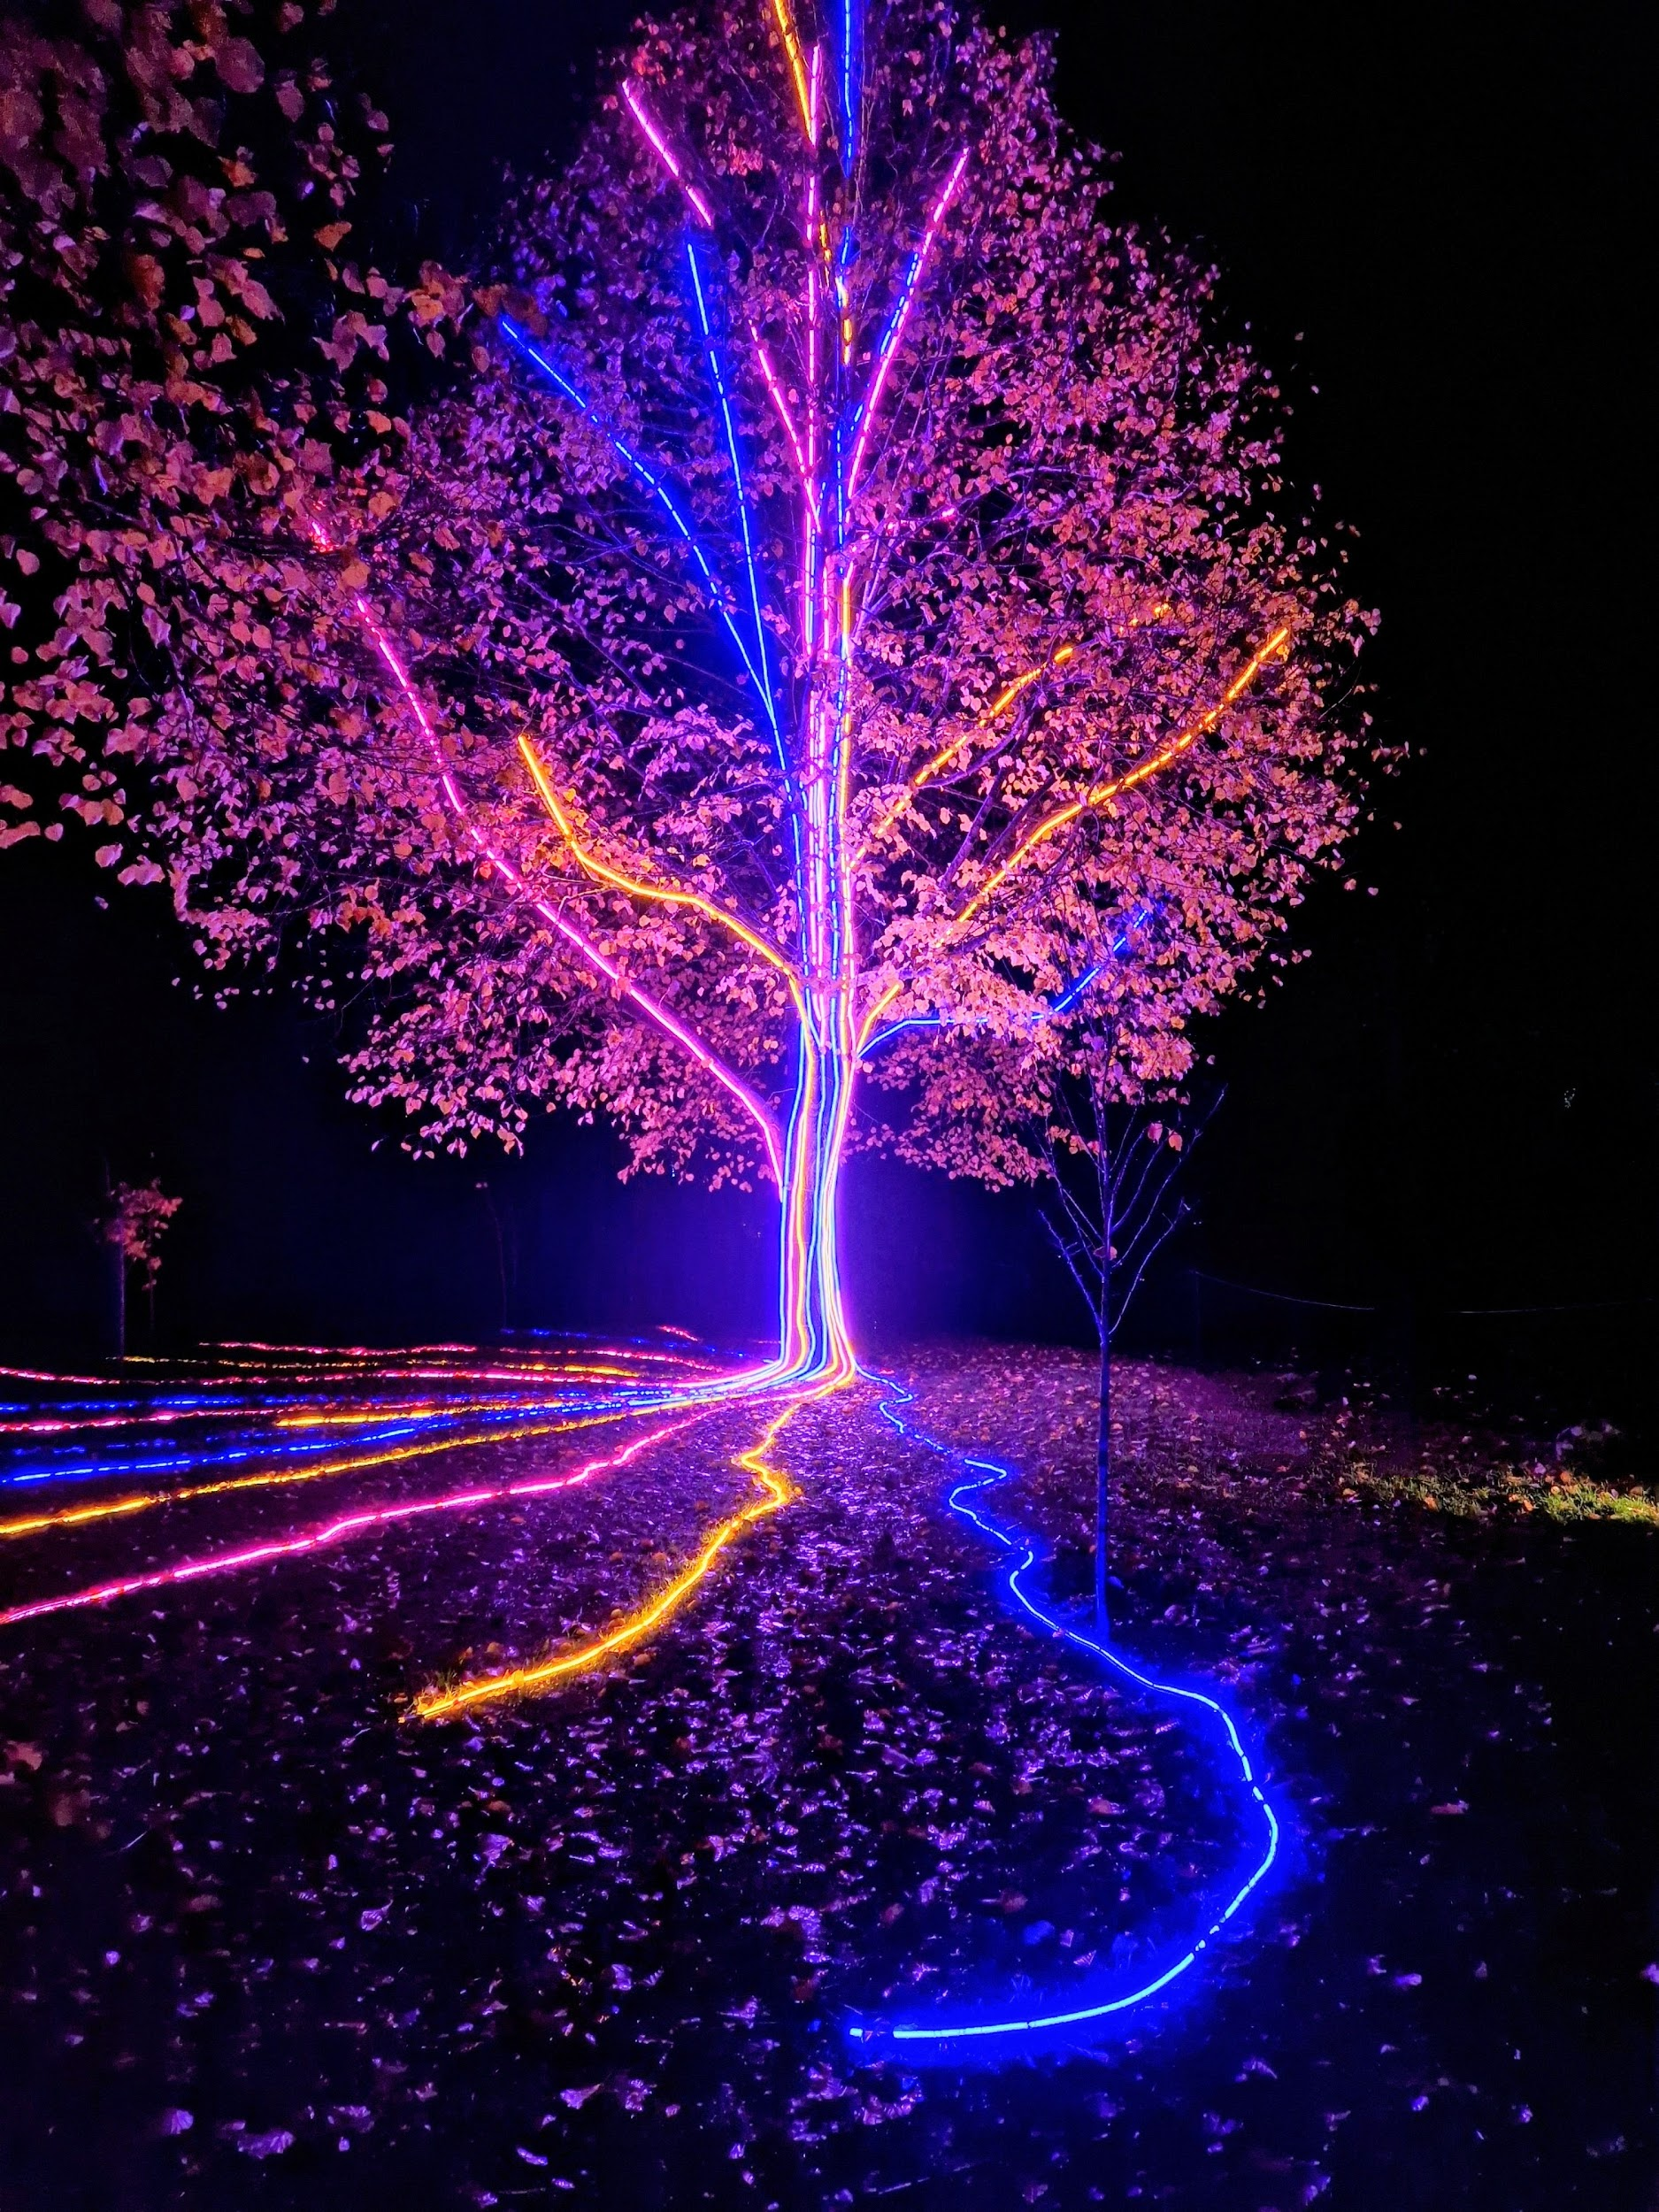
Storm Walker
Storm Walker
Symbolising, trust in Jesus Christ through life's storms.
Mark 4:35-41

Slide 45


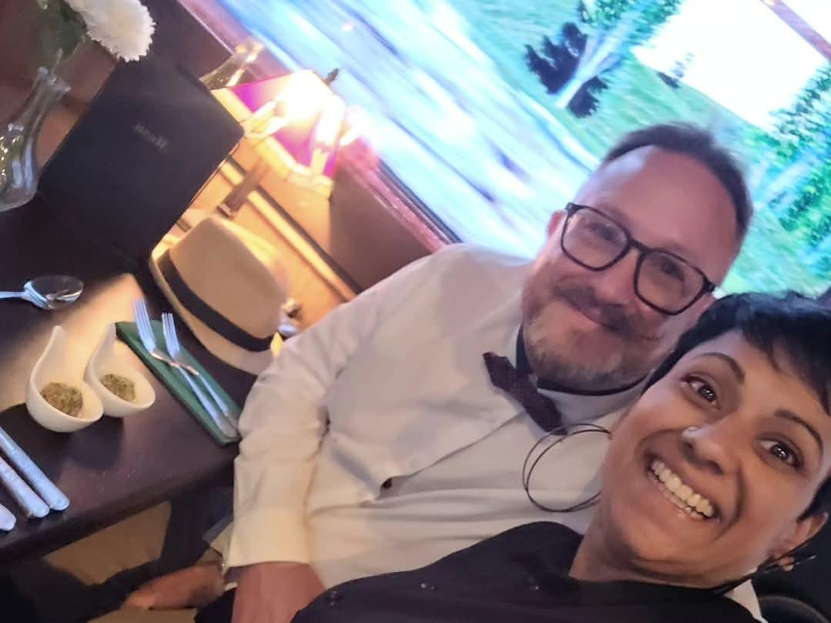
Group Leaders
Micheal and Mwamba
Wilfred and Parveen
Hannah

Slide 46
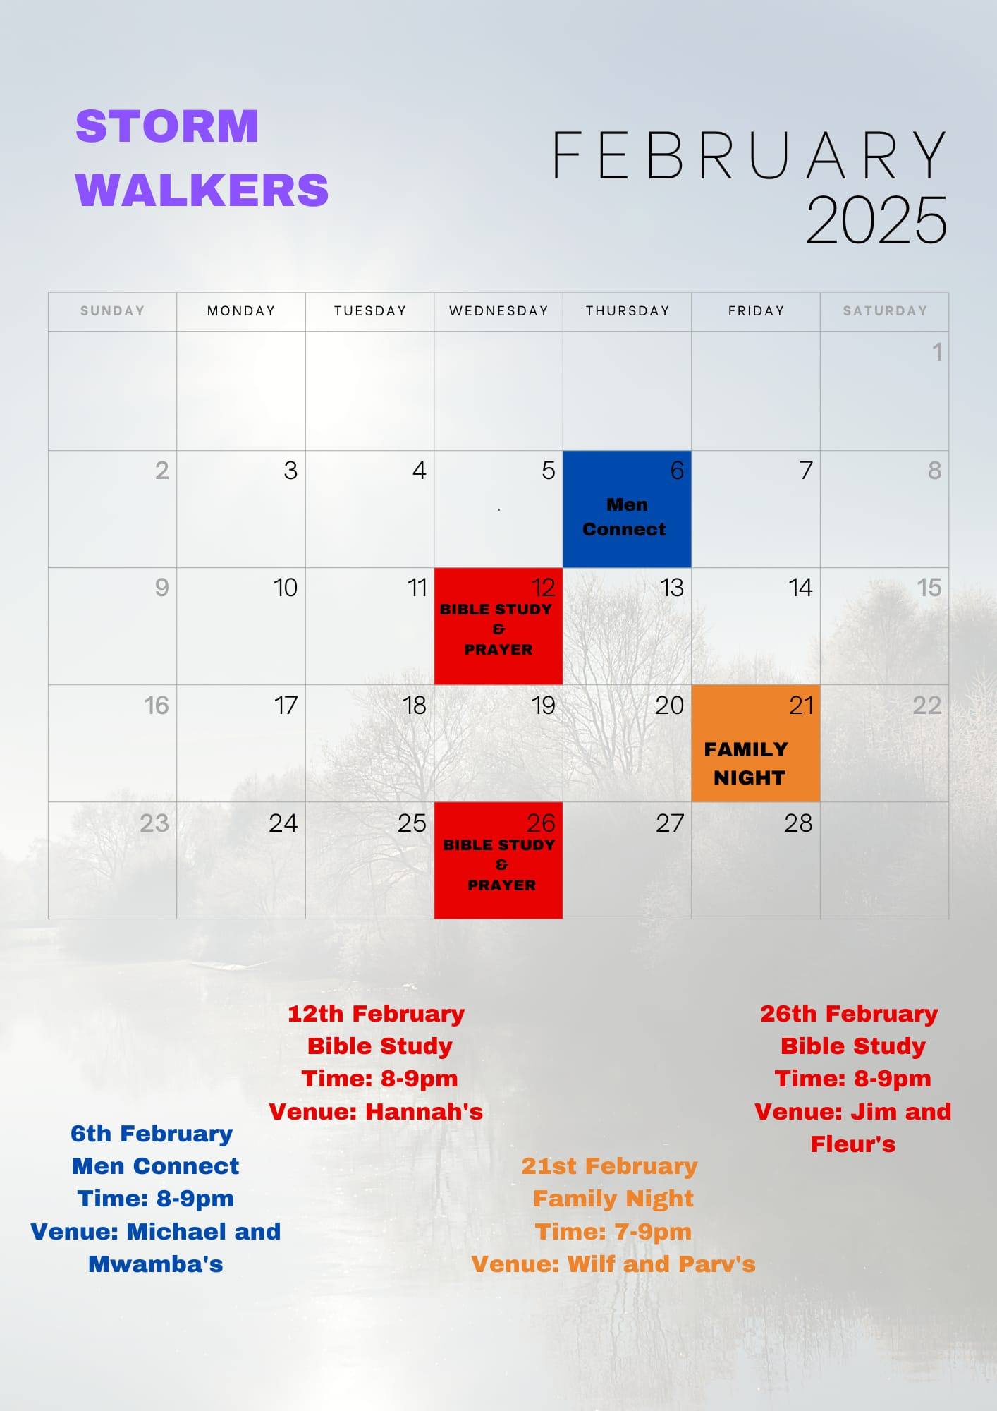

Slide 47
The Bereavement Journey
The Bereavement Journey is for anyone who has been bereaved at any time and in any way Starts Monday 3rd March
7 Sessions ending at Easter
Daytime group 10.30am to 12.30pm Jasper Centre
They may look to run another one in the evening later in the year
Please note that (as the video highlights) this is for anyone that has lost someone in their life
who would benefit and value time to reflect and work through their grief and loss.
It doesn’t have to be very recently. Angela and Lena

Slide 48


Slide 49


Slide 50


Slide 51
2 Corinthians 14 May the grace of the Lord Jesus Christ, and the love of God, and the fellowship of the Holy Spirit be with you all
Surely goodness and mercy shall follow me all the days of my life, and I shall dwell in the house of the Lord forever.

